Slide 1

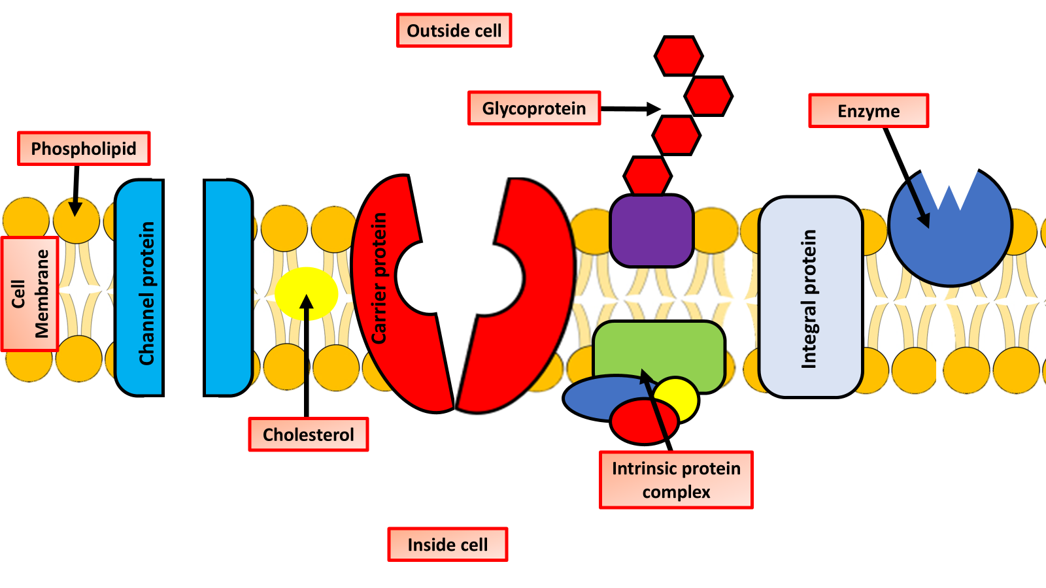

The Great Biology Pubish Quiz
Fluid Mosaic

Slide 2

The Great Biology Pubish Quiz
Fluid Mosaic
What does the "fluid" part of the fluid mosaic model refer to?
A
Movement of proteins
Movement of phospholipids
B
C
Solubility in water
D
Presence of enzymes

Slide 3
The Great Biology Pubish Quiz
Fluid Mosaic
What is the primary structural component of a cell membrane?
A
Cellulose
Phospholipid bilayer
B
C
Glycoprotein
D
DNA

Slide 4
The Great Biology Pubish Quiz
Fluid Mosaic
What role do cholesterol molecules play in the membrane?
A
Energy storage
Protein production
B
C
Membrane stability and fluidity
D
Cell division

Slide 5
The Great Biology Pubish Quiz
Fluid Mosaic
What is the role of intrinsic (integral) proteins in the membrane?
A
DNA replication
Membrane lubrication
B
C
Transport of molecules
D
Enzyme synthesis

Slide 6
The Great Biology Pubish Quiz
Fluid Mosaic
What are glycoproteins in the membrane involved in?
A
Cell recognition and signalling
DNA transport
B
C
Protein synthesis
D
ATP production

Slide 7
The Great Biology Pubish Quiz
Fluid Mosaic
Why is the model called a “mosaic”?
A
Because it’s rigid and patterned
B
Because the phospholipids are symmetrical
C
Because proteins are scattered throughout like tiles
D
Because carbohydrates form a repeating structure

Slide 8

The Great Biology Pubish Quiz
Fluid Mosaic
Question 1
B
Question 2
B
Question 3
C
Question 4
C
Question 5
A
Question 6
C

