Slide 1
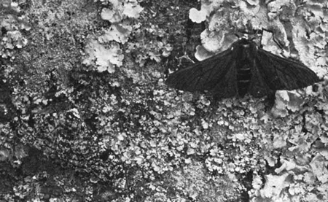

Peppered Moth Evolution Question
The picture below shows the peppered moth.
Video Link
Why did the colour of the peppered moth change over time?
What caused the trees to get darker during the Industrial Revolution?
Why did darker moths survive better than lighter moths in polluted areas?
What is the name of the process that caused the change in peppered moths over time?

