Slide 1


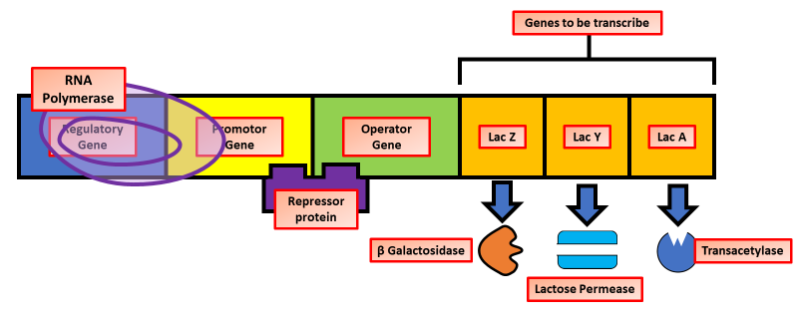
The Great Biology Pubish Quiz
Lac Operon

Slide 2
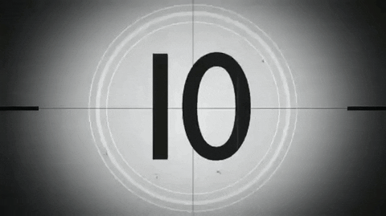
The Great Biology Pubish Quiz
Lac Operon
What is the function of the lac operon in E. coli?
A
To regulate the metabolism of lactose
To produce glucose
B
C
To inhibit RNA polymerase
D
To transport oxygen

Slide 3
The Great Biology Pubish Quiz
Lac Operon
What binds to the operator region of the lac operon when lactose is absent?
A
RNA polymerase
Repressor protein
B
C
Lactose
D
DNA ligase

Slide 4
The Great Biology Pubish Quiz
Lac Operon
Which enzyme does the lacZ gene code for?
A
Permease
Transacetylase
B
C
DNA polymerase
D
β-galactosidase

Slide 5
The Great Biology Pubish Quiz
Lac Operon
What happens to the repressor protein when lactose is present?
A
It binds to the promoter
It changes shape and detaches from the operator
B
C
It inhibits RNA polymerase
D
It stops transcription

Slide 6
The Great Biology Pubish Quiz
Lac Operon
What role does allolactose play in lac operon regulation?
A
It acts as an inducer by inactivating the repressor
It binds to the operator
B
C
It prevents transcription
D
It degrades lactose

Slide 7
The Great Biology Pubish Quiz
Lac Operon
Which of the following best describes the lac operon?
A
Constitutive gene expression
B
Positive feedback loop
C
Inducible operon
D
Always active

Slide 8

The Great Biology Pubish Quiz
Lac Operon
Question 1
A
Question 2
B
Question 3
D
Question 4
B
Question 5
A
Question 6
C

