Slide 1

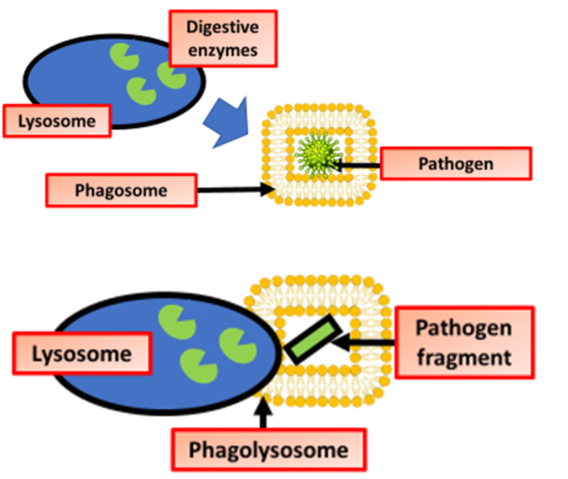

The Great Biology Pubish Quiz
Phagocytosis

Slide 2

The Great Biology Pubish Quiz
Phagocytosis
What is the first step of phagocytosis?
A
Phagosome formation
Pathogen recognition
B
C
Digestive enzyme release
D
Exocytosis

Slide 3
The Great Biology Pubish Quiz
Phagocytosis
Which type of cell primarily carries out phagocytosis?
A
Phagocytes
Erythrocytes
B
C
Lymphocytes
D
Platelets

Slide 4
The Great Biology Pubish Quiz
Phagocytosis
What structure is formed when a pathogen is engulfed by a phagocyte?
A
Lysosome
Antibody
B
C
Phagosome
D
Ribosome

Slide 5
The Great Biology Pubish Quiz
Phagocytosis
Which organelle fuses with the phagosome to break down the pathogen?
A
Nucleus
Mitochondrion
B
C
Lysosome
D
Golgi apparatus

Slide 6
The Great Biology Pubish Quiz
Phagocytosis
Which of the following is released by phagocytes to attract more immune cells?
A
Cytokines
Glucose
B
C
Antibodies
D
Cholesterol

Slide 7
The Great Biology Pubish Quiz
Phagocytosis
After digestion of the pathogen, how are the waste materials removed?
A
Endocytosis
B
Diffusion
C
Exocytosis
D
Osmosis

Slide 8

The Great Biology Pubish Quiz
Phagocytosis
Question 1
B
Question 2
A
Question 3
C
Question 4
C
Question 5
A
Question 6
C

