Slide 1
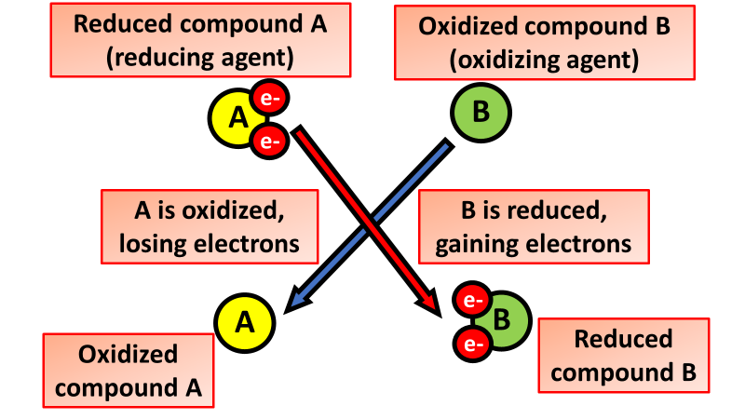

Reduction Question
Explain what is meant by reduction and describe how it occurs in terms of electrons.
_______________________________________________________________________________________________________________________________________________________________________________________________________________________________________________________________________________________________________________________________________________________________________________________________________________________________________
Answer
Link to video

