Slide 1
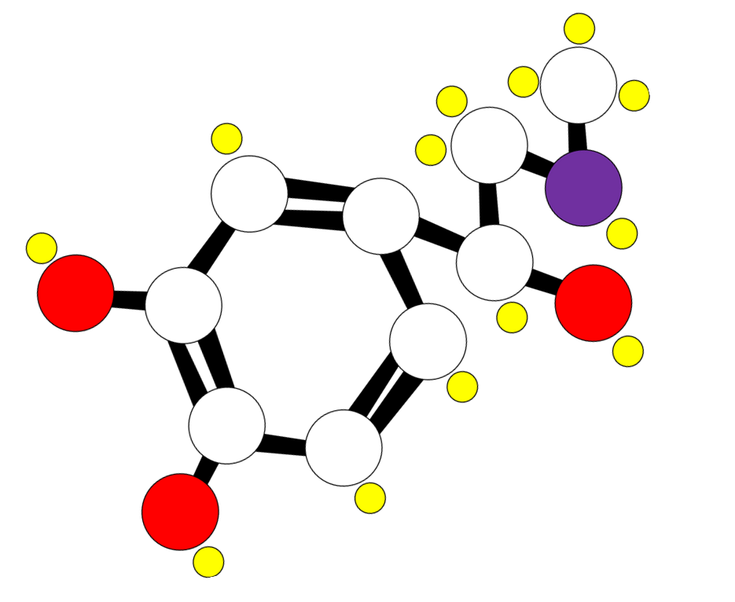

Adrenaline Action Question
Describe four physiological effects of adrenaline on the human body and explain how each effect prepares the body for a ‘fight or flight’ response.
____________________________________________________________________________________________________________________________________________________________________________________________________________________________________________________________________________________________________________________________________________________________________________________________________________________________________________________________________________________________________________________________________________________________________________________
Answer
Video link

