Slide 1
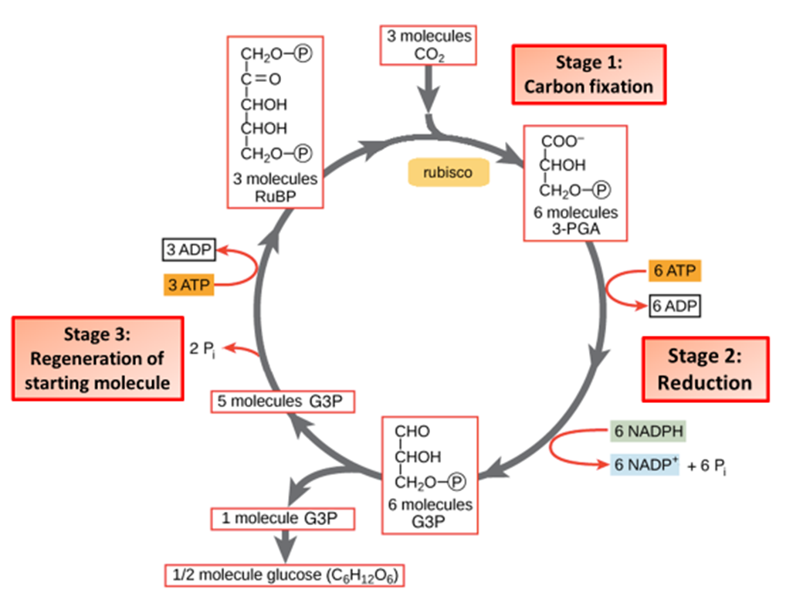

Carbon Dioxide as a Limiting Factor Question
Explain why increasing carbon dioxide concentration increases the rate of glucose production in photosynthesis (up to a point).
____________________________________________________________________________________________________________________________________________________________________________________________________________________________________________________________________________________________________________________________________________________________________________________________________________________________________________________________________________________________________________________________________________________________________________________
Answer
Video link

