Slide 1

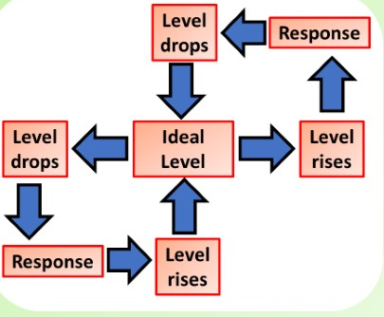
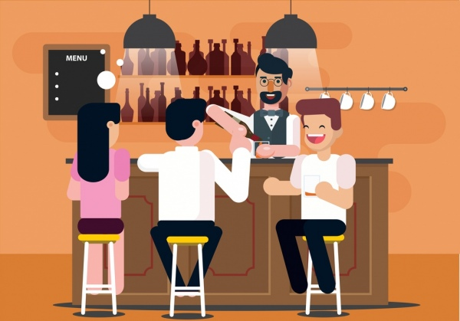
The Great Biology Pubish Quiz
Principles of Homeostasis

Slide 2

The Great Biology Pubish Quiz
Principles of Homeostasis
What is the main purpose of homeostasis in the body?
A
To generate energy
To remove waste
B
C
To promote growth
D
To maintain a stable internal environment

Slide 3
The Great Biology Pubish Quiz
Principles of Homeostasis
Which organ is primarily responsible for regulating blood glucose levels?
A
Kidney
Liver
B
C
Pancreas
D
Heart

Slide 4
The Great Biology Pubish Quiz
Principles of Homeostasis
What type of feedback mechanism is most commonly used in homeostasis?
A
Positive feedback
Electrical feedback
B
C
Thermal feedback
D
Negative feedback

Slide 5
The Great Biology Pubish Quiz
Principles of Homeostasis
Which hormone lowers blood glucose levels?
A
Glucagon
Insulin
B
C
Adrenaline
D
Cortisol

Slide 6
The Great Biology Pubish Quiz
Principles of Homeostasis
Which part of the brain controls body temperature?
A
Medulla
Pituitary gland
B
C
Hypothalamus
D
Cerebellum

Slide 7
The Great Biology Pubish Quiz
Principles of Homeostasis
What is the term for maintaining constant water balance in the body?
A
Thermoregulation
B
Osmoregulation
C
Glucoregulation
D
Hydration

Slide 8

The Great Biology Pubish Quiz
Principles of Homeostasis
Question 1
D
Question 2
C
Question 3
D
Question 4
B
Question 5
C
Question 6
B

