Slide 1
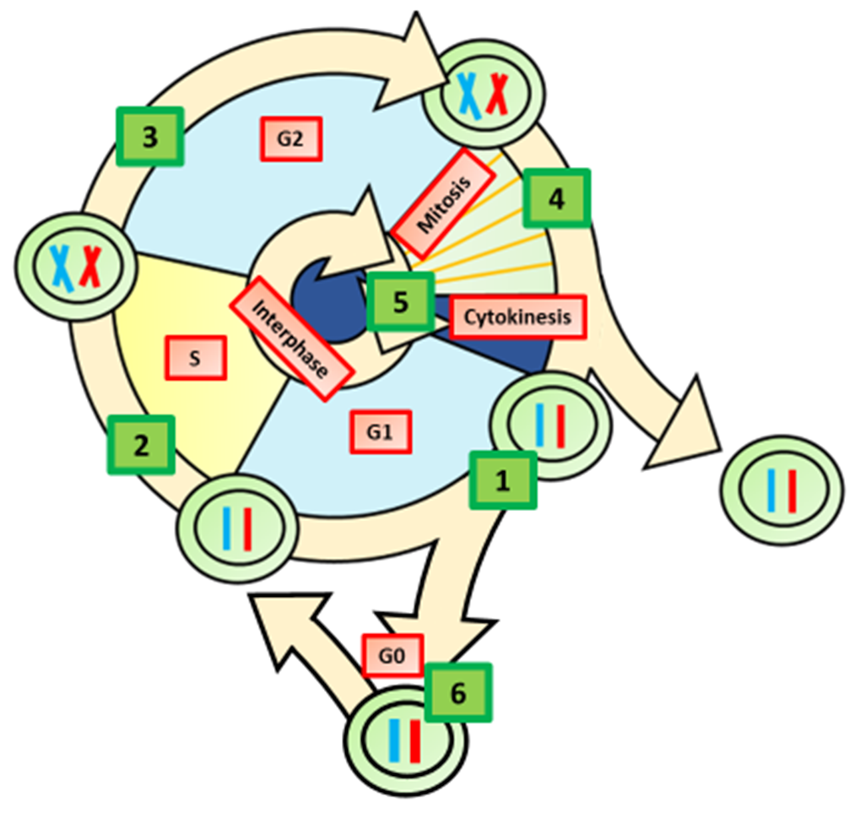

Cell Cycle Check Points Question
Describe the role of checkpoints during the cell cycle and explain why they are essential for healthy cell division.
____________________________________________________________________________________________________________________________________________________________________________________________________________________________________________________________________________________________________________________________________________________________________________________________________________________________________________________________________________________________________________________________________________________________________________________
Answer
Video link

