Slide 1
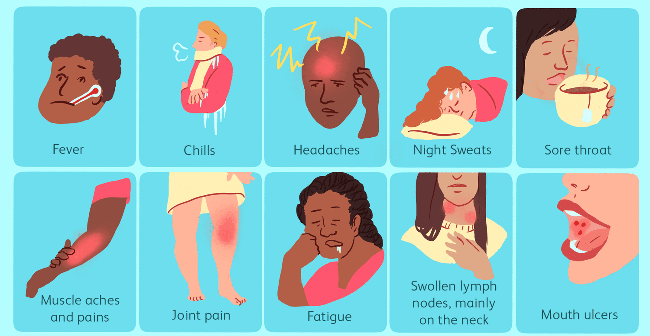

HIV Question
HIV is an infectious disease. Describe the characteristics and effects of HIV
____________________________________________________________________________________________________________________________________________________________________________________________________________________________________________________________________________________________________________________________________________________________________________________________________________________________________________________________
Answer
Video link

