Slide 1
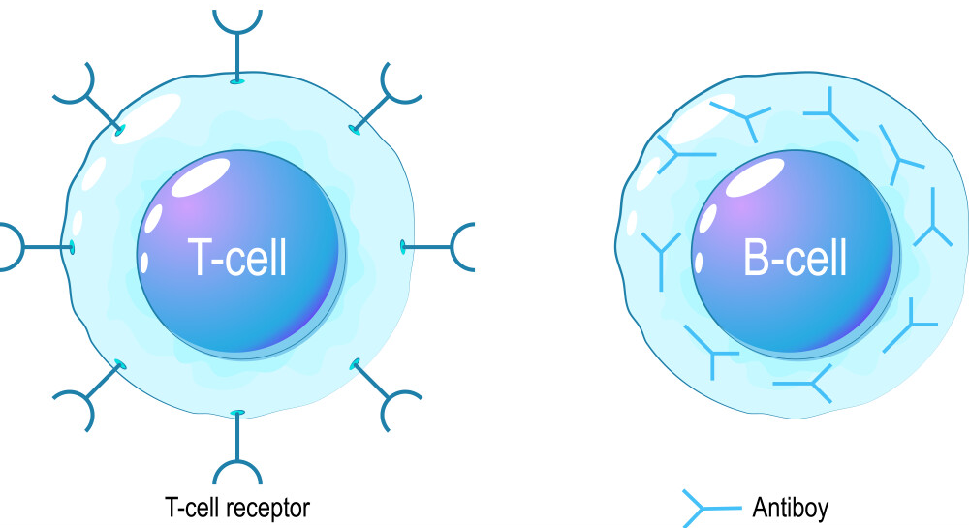

The Role of T Cells & B Cells Question
Explain the role of B-lymphocytes and T-lymphocytes in the defence of the body against a virus infection
________________________________________________________________________________________________________________________________________________________________________________________________________________________________________________________________________________________________________________________________________________________________________________________________________________________________________________________________________________________________________________________________________________________________________________________________________________________________________________________________________________________________________________________________________________________________________________
Answer
Link to video

Slide 2




Click here to access my immunity youtube videos
Resources that this activity would work well with
Lesson on TES
Lesson on TPT
Follow me on social media to stay in touch
Keep up to date with my new content:

