Slide 1
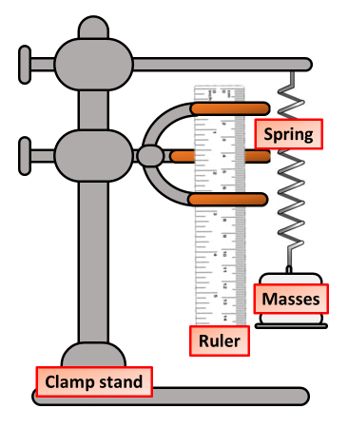

Hooke’s Law Practical Question
The diagram below shows equipment used in a Hooke’s Law investigation
Mark Scheme
What piece of equipment is used to measure the extension of a spring?
What is the independent variable in a Hooke’s Law experiment?
How do you calculate the extension of a spring?
What should you do to ensure accurate results when measuring extension?

