Slide 1

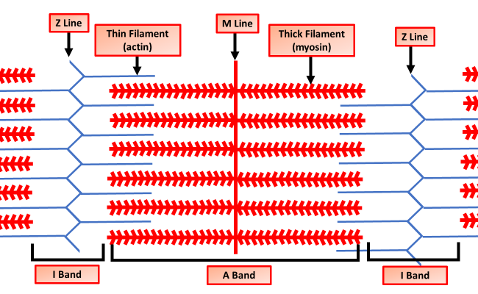

The Great Biology Pubish Quiz
Sliding Filament Model

Slide 2

The Great Biology Pubish Quiz
Sliding Filament Model
Which protein forms the thin filament in a muscle fibre?
A
Myosin
Troponin
B
C
Tropomyosin
D
Actin

Slide 3
The Great Biology Pubish Quiz
Sliding Filament Model
Which ion is essential for exposing binding sites on actin?
A
Sodium
Potassium
B
C
Calcium
D
Magnesium

Slide 4
The Great Biology Pubish Quiz
Sliding Filament Model
Which molecule provides the energy for the sliding filament mechanism?
A
Glucose
ATP
B
C
NADH
D
ADP

Slide 5
The Great Biology Pubish Quiz
Sliding Filament Model
What is formed when myosin heads attach to actin?
A
Crossbridge
Sarcomere
B
C
Filament
D
Vesicle

Slide 6
The Great Biology Pubish Quiz
Sliding Filament Model
What structure shortens during muscle contraction?
A
Myofibril
Sarcolemma
B
C
Sarcoplasm
D
Ribosome

Slide 7
The Great Biology Pubish Quiz
Sliding Filament Model
What blocks the myosin binding site on actin when the muscle is relaxed?
A
Keratin
B
Tropomyosin
C
Myoglobin
D
Collagen

Slide 8

The Great Biology Pubish Quiz
Sliding Filament Model
Question 1
A
Question 2
C
Question 3
B
Question 4
A
Question 5
A
B

