Slide 1
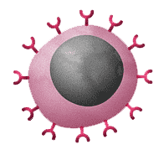

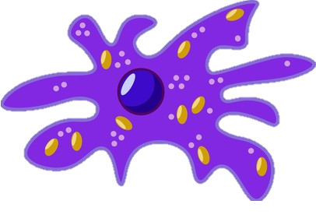
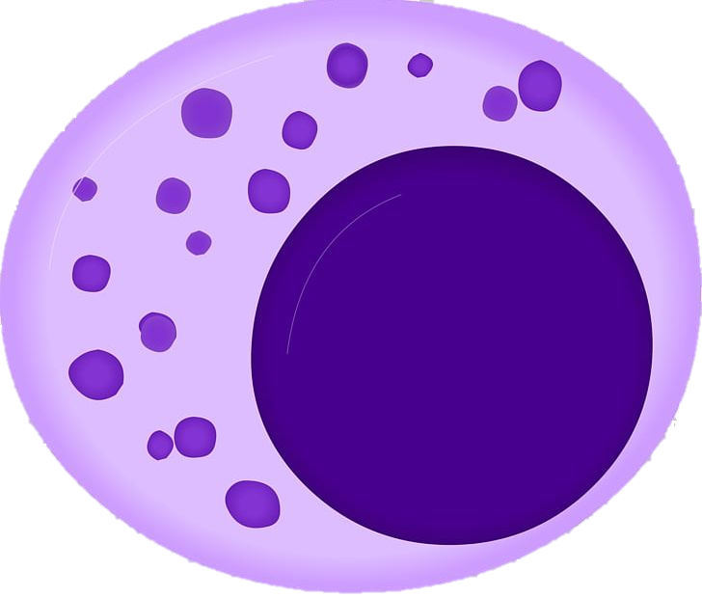

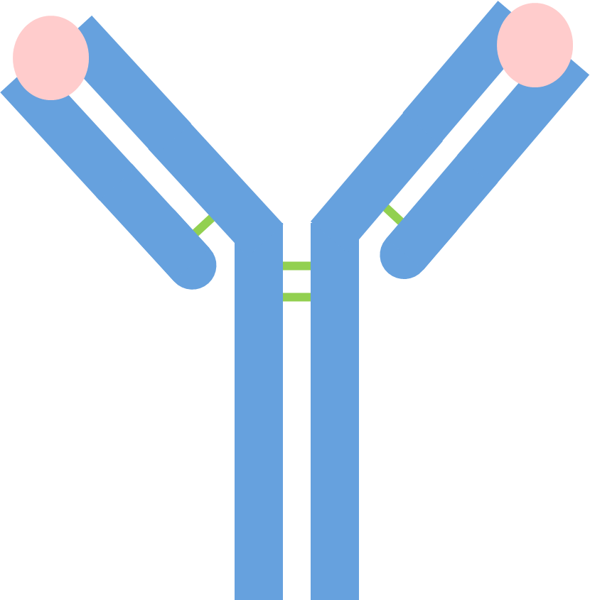
Parts of the Immune Systems
B Lymphocytes (B Cells): White blood cells that produce antibodies to neutralize pathogens or mark them for destruction.
Red blood cells: These are the cells in the blood that make it look red, are full of haemoglobin and carry oxygen
Phagocytes: A type of white blood cell that engulfs and digests pathogens through a process called phagocytosis.
Blood vessel
Red blood cell
B lymphocyte
Phagocyte
T lymphocyte
Platelets
T Lymphocytes (T Cells): White blood cells that help coordinate the immune response or directly destroy infected or cancerous cells. Includes helper T cells and killer T cells.
Antibodies: Antibodies are proteins made by white blood cells that help defend the body against pathogens. They bind to specific antigens on the surface of pathogens, marking them for destruction by other immune cells.
Platelets: Platelets are small fragments of cells in the blood that help it to clot. They gather at the site of a wound, form a plug, and release chemicals to trigger a clotting process, which stops bleeding and prevents infection.

Slide 2
Parts of the Immune Systems
B Lymphocytes (B Cells):
Red blood cells:
Phagocytes:
Blood vessel
Red blood cell
B lymphocyte
Phagocyte
T lymphocyte
Platelets
T Lymphocytes (T Cells):
Antibodies:
Platelets:

