Slide 1
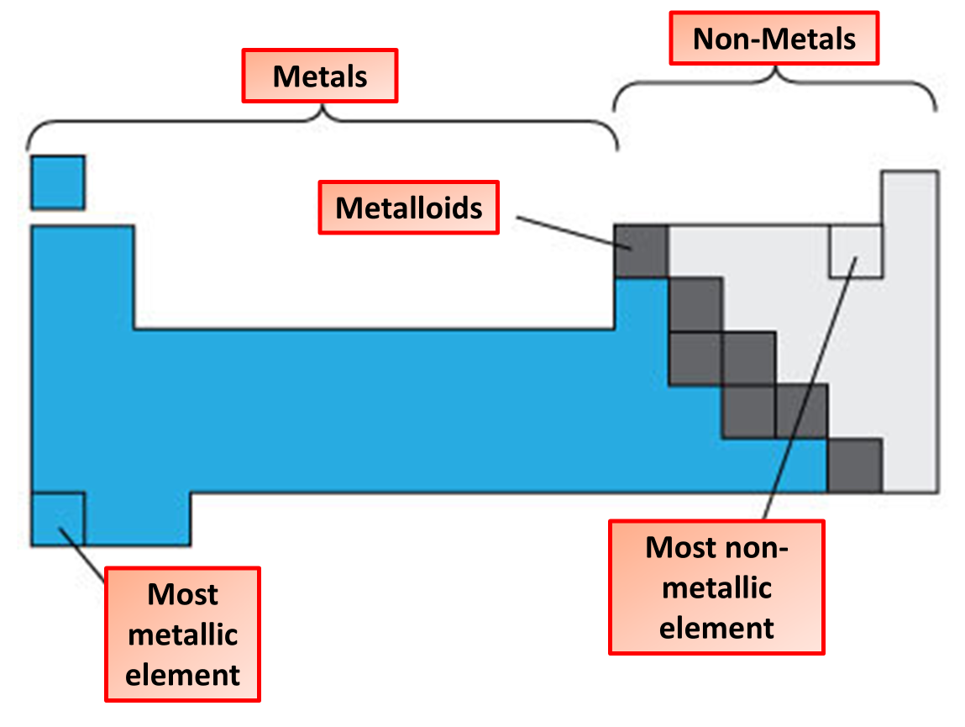

Periodic Table Question
The diagram shows the periodic table:
Video link
What is an element?
What are the vertical columns in the periodic table called?
What are the horizontal rows in the periodic table called?
What type of elements are found on the right side of the periodic table?

