Slide 1
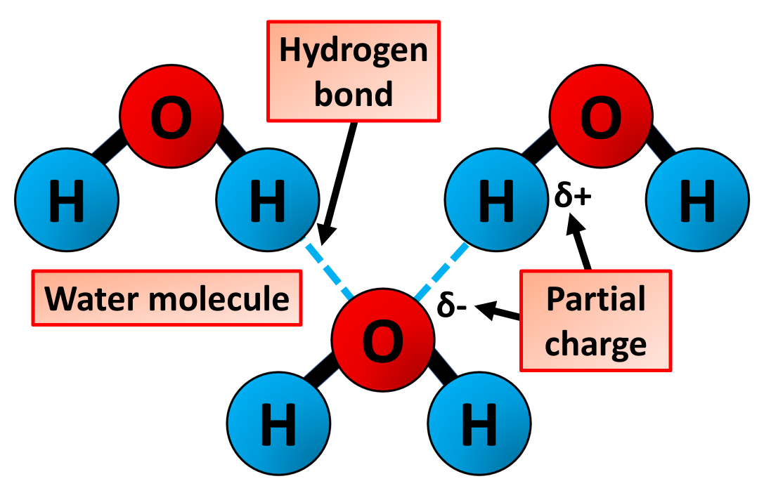

Water Question
The diagram below shows water molecules. Explain how the structure of water makes it important for living organisms.
________________________________________________________________________________________________________________________________________________________________________________________________________________________________________________________________________________________________________________________________________________________________________________________________________________________________________________________________________________________________________________________________________________________________________________________________________________________________________________________________________________________________________________________________________________________________________________
Answer
Link to video

