Slide 1
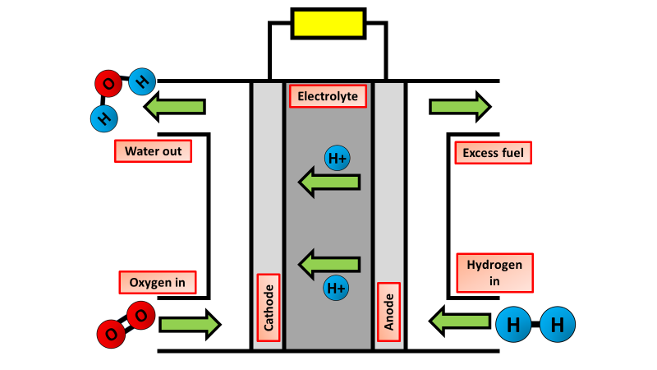
Hydrogen Fuel Cells Practice Question
The diagram below shows a hydrogen fuel cell
Describe in detail what a hydrogen fuel cell is and how it works
Key things to think about:
What ions are formed
Where do the ions move
How is water form as a byproduct
________________________________________________________________________________________________________________________________________________________________________________________________________________________________________________________________________________________________________________________________________________________________________________________________________________________________________________________________________________________________________________________________________________________________________
Answer

