Slide 1
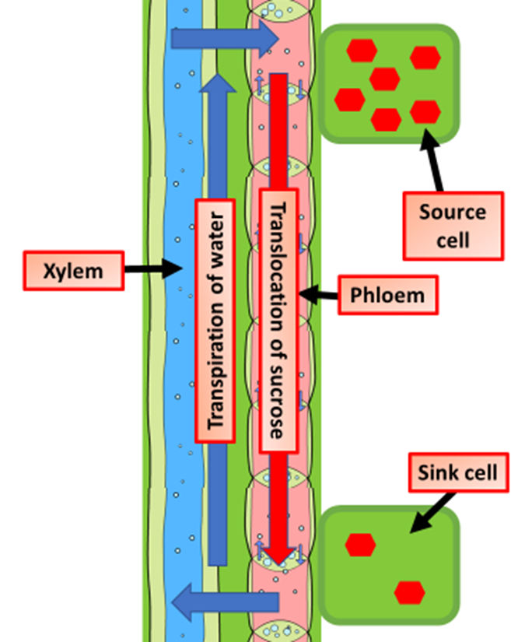
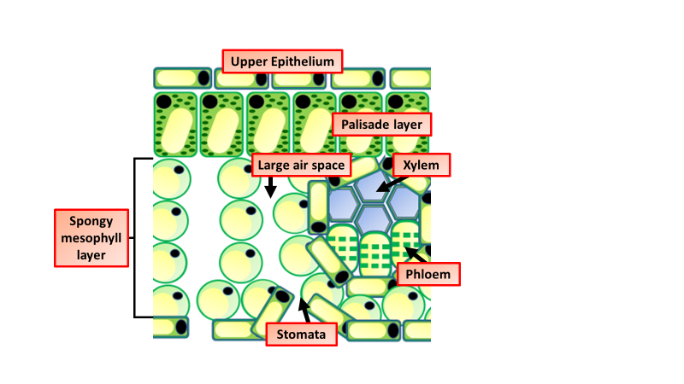

Plant Tissues Question
The diagram shows the tissues that make up a plant. Which part of a plant is the largest? Tick one box:
A guard cell
A leaf
A root hair
What is the function of xylem tissue in plants?
The diagram below shows the structure of a leaf. Which plant tissue is responsible for photosynthesis?
What cells transport water?
Video link

