Slide 1
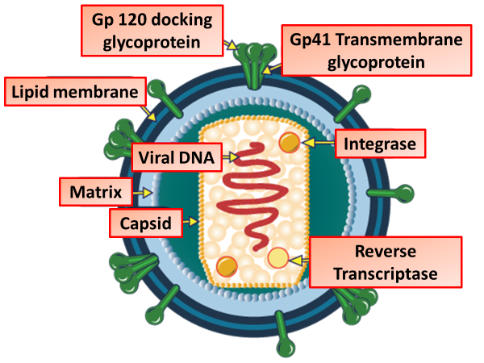

HIV Question
Describe the cause, transmission, and effects of HIV in humans.
____________________________________________________________________________________________________________________________________________________________________________________________________________________________________________________________________________________________________________________________________________________________________________________________________________________________________________________________________________________________________________________________________________________________________________________
Answer
Video link

