Slide 1
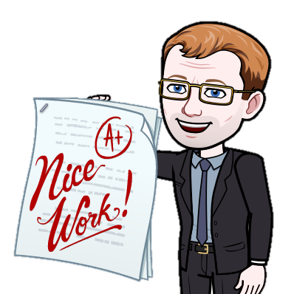








?
?
?
?
12 Questions to Improve Revision
?
?
?
What to ask yourself before revision
How much time do I have?
How can I spread out my revision?
Can I vary the subjects I revise in one day?
Have I removed any potential distractions?
What questions can I answer before revising?
What to ask yourself during revision
Who can quiz me on what I’m revising?
Is there anything else I can add to my answers?
Why is this the answer?
Have I done any past papers?
What to ask yourself after revision
Where can I look for help if I need it?
Who can I teach this to?
Am I getting enough sleep?

