Slide 1
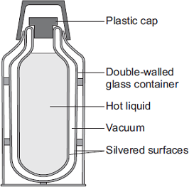

Vacuum Flask Practice Question
The diagram shows the structure of a vacuum flask. A vacuum flask is designed to reduce the rate of energy transfer by heating processes.
Describe how the design of a vacuum flask keeps the liquid inside hot.
Key things to include:
How does a vacuum help reduce heat loss
How does a silver surface help reduce heat loss
How does glass help reduce heat loss
How does a plastic cap help reduce heat loss
_____________________________________________________________________________________________________________________________________________________________________________________________________________________________________________________________________________________________________________________________________________________________________________________________________________________________________________________________________________________________________________________________________
Answer
Link to video

Slide 2
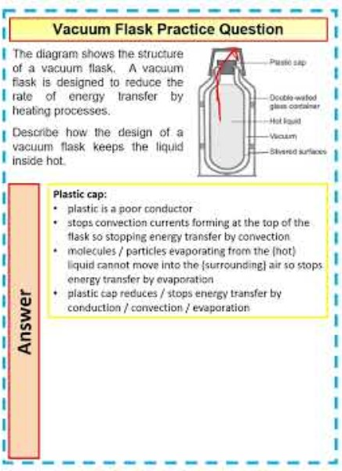
Vacuum Flask Practice Question

