Slide 1
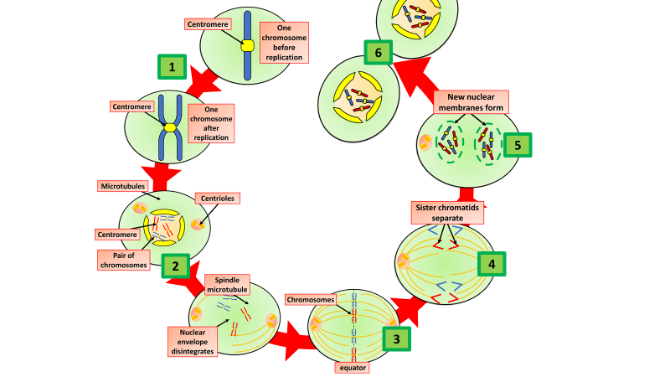

Mitosis Question
The larvae of the hornet moth form when fertilised eggs divide by mitosis.
Describe how mitosis produces two genetically identical cells.
Key things to include:
What happens to the DNA
How are chromosomes moved
What happens to the cell
Why are the 2 cells identital
______________________________________________________________________________________________________________________________________________________________________________________________________________________________________________________________________________________________________________________________________________________________________________________________________________________________________________________________________________________
Answer
Link to video

Slide 2
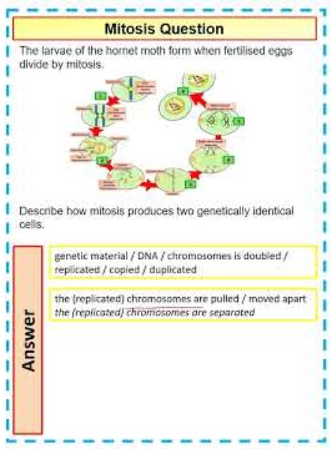
Mitosis Question

Slide 3

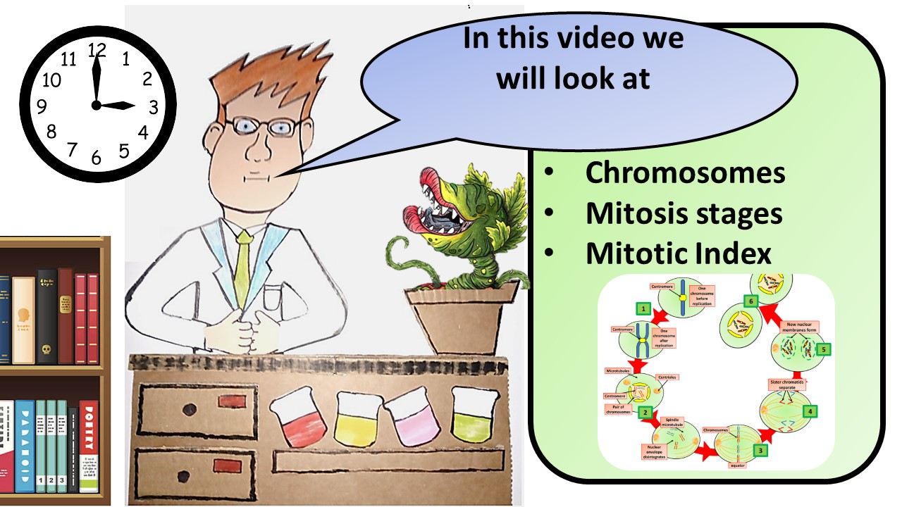


Click here to access my youtube videos
Resources that this activity would work well with
Lesson on TES
Lesson on TPT
Follow me on social media to stay in touch
Keep up to date with my new content:

