Slide 1
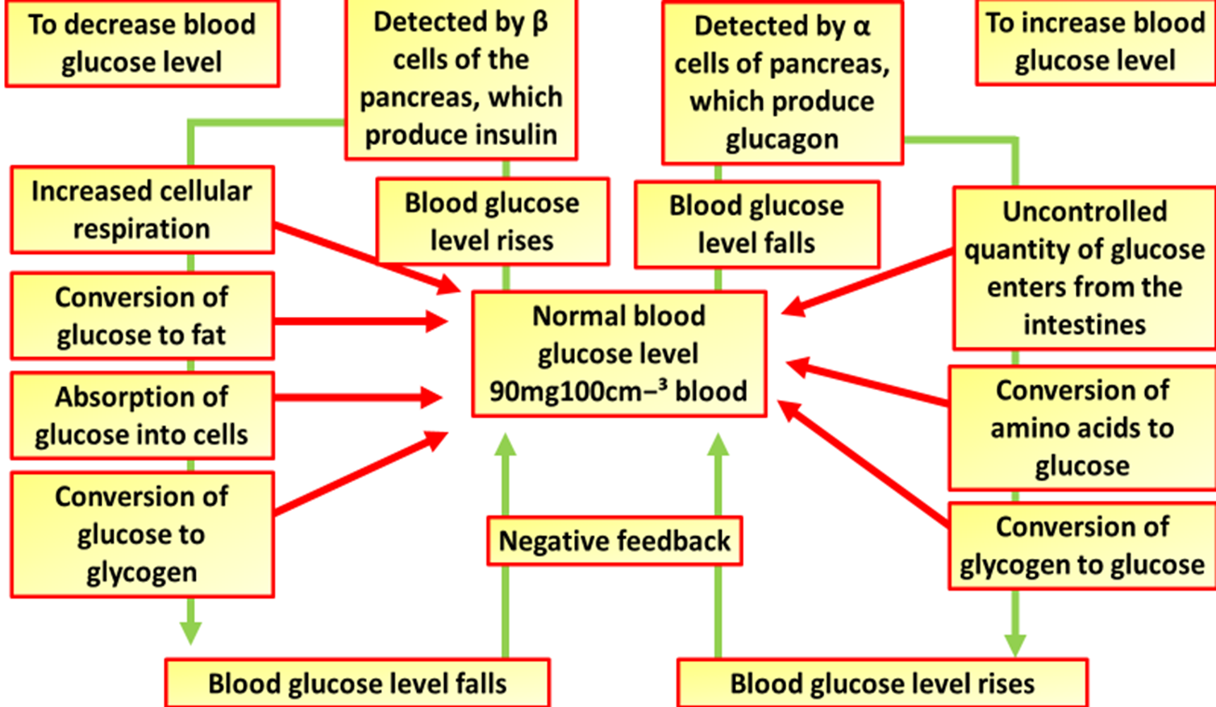
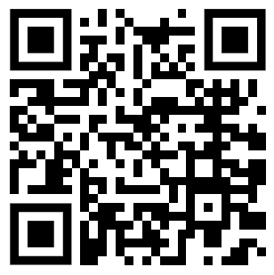
Blood Glucose Control Question
The diagram below shows how blood glucose is controlled
Explain how the release of insulin is controlled
________________________________________________________________________________________________________________________________________________________________________________________________________________________________________________________________________________________________________________________________________________________________________________________________________________________________________________________________________________________________________________________________________________________________________________________________________________________________________________________________________________________________________________________________________________________________________________
Answer
Link to video

Slide 2
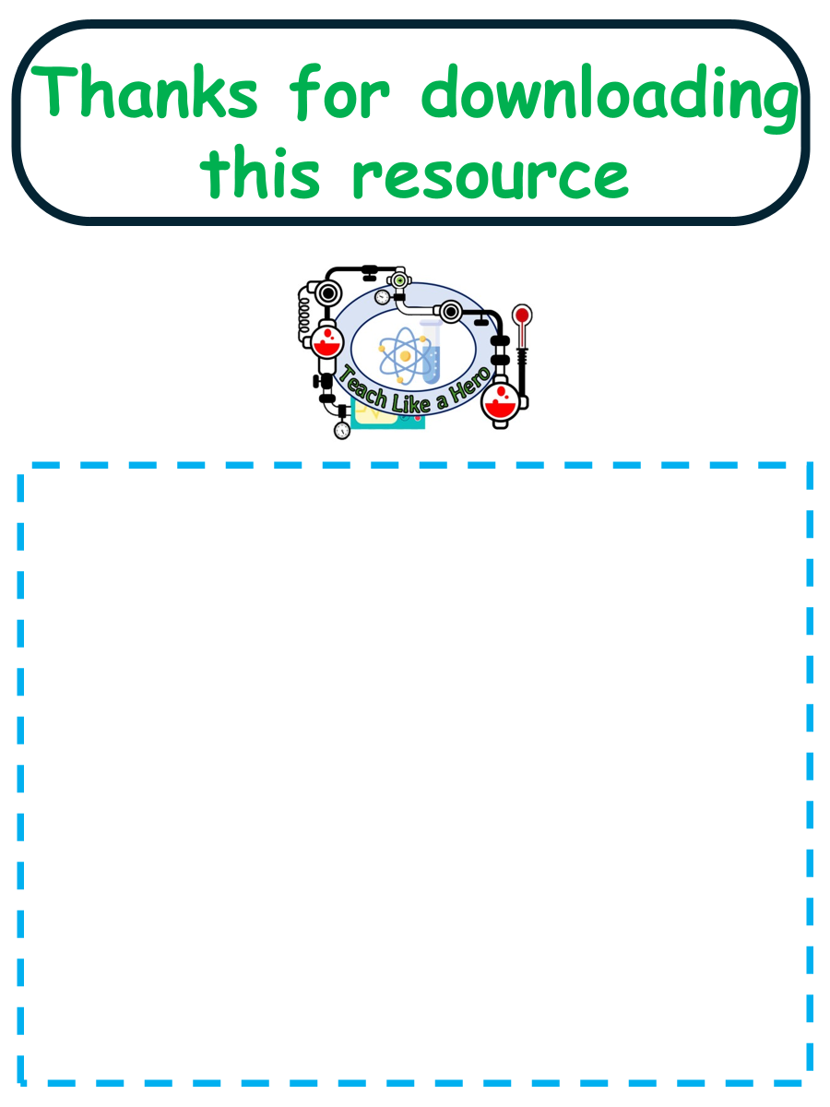
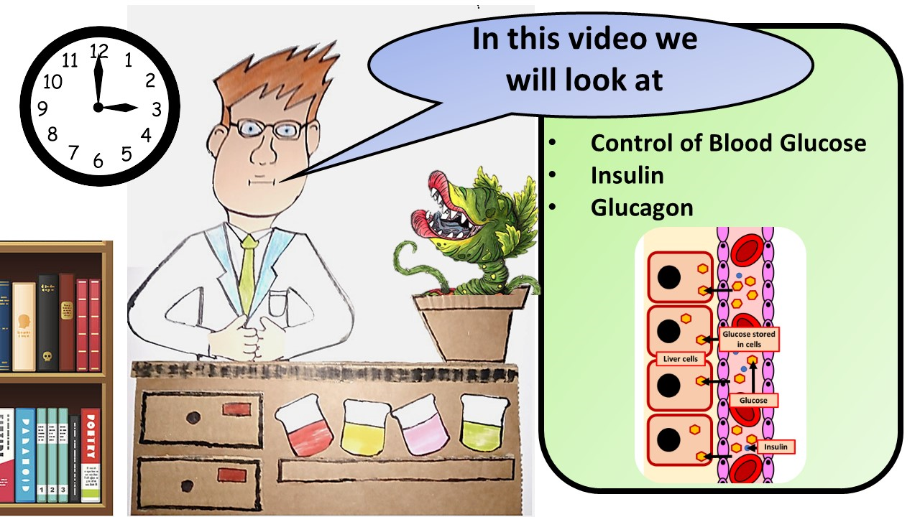


Click here to access my DNA youtube videos
Resources that this activity would work well with
Lesson on TES
Lesson on TPT
Follow me on social media to stay in touch
Keep up to date with my new content:

