Slide 1
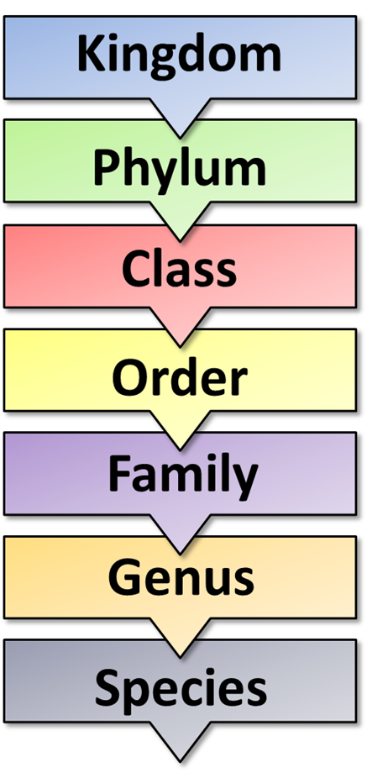
The Great Biology Pubish Quiz
Classification

Slide 2
The Great Biology Pubish Quiz
Classification
What is the highest taxonomic rank in biological classification?
A
Kingdom
Class
B
C
Domain
D
Order

Slide 3
The Great Biology Pubish Quiz
Classification
Which classification system is based on evolutionary relationships?
A
Linnaean classification
Phylogenetics
B
C
Artificial classification
D
Binomial nomenclature

Slide 4
The Great Biology Pubish Quiz
Classification
What is the correct order of taxonomic ranks from most general to most specific?
A
Kingdom, Phylum, Class, Order, Family, Genus, Species
Species, Genus, Family, Order, Class, Phylum, Kingdom
B
C
Phylum, Kingdom, Class, Order, Genus, Species
D
Kingdom, Class, Order, Phylum, Family, Genus, Species

Slide 5
The Great Biology Pubish Quiz
Classification
What is the correct format for writing a species name using binomial nomenclature?
A
HOMO SAPIENS
Homo sapiens
B
C
homo sapiens
D
Homo Sapiens

Slide 6
The Great Biology Pubish Quiz
Classification
Which of the following kingdoms contains only prokaryotic organisms?
A
Protista
Fungi
B
C
Archaea
D
Plantae

Slide 7
The Great Biology Pubish Quiz
Classification
What is the main basis for classifying organisms in the three-domain system?
A
Morphology
B
DNA and RNA sequences
C
Number of cells
D
Type of nutrition

Slide 8
The Great Biology Pubish Quiz
Classification
Question 1
C
Question 2
B
Question 3
A
Question 4
B
Question 5
C
Question 6
B

