Slide 1
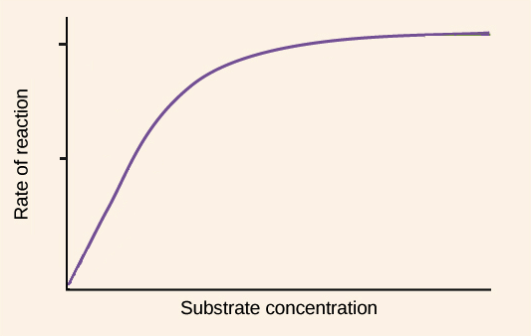

Enzyme Activity Question
A student investigates the effect of substrate concentration on enzyme activity. The graph shows the rate of reaction increasing and then levelling off.
Explain this trend using your knowledge of enzyme action.
____________________________________________________________________________________________________________________________________________________________________________________________________________________________________________________________________________________________________________________________________________________________________________________________________________________________________________________________________________________________________________________________________________________________________________________
Answer
Link to video

