Slide 1
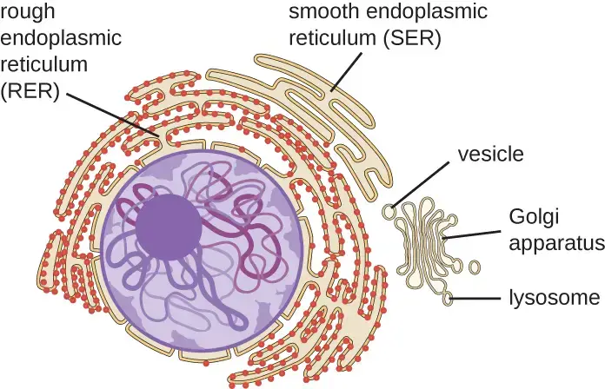

Golgi & Endoplasmic Reticulum Question
Describe how the rough endoplasmic reticulum and the Golgi apparatus are involved in the production of a secretory vesicle that contains protein.
____________________________________________________________________________________________________________________________________________________________________________________________________________________________________________________________________________________________________________________________________________________________________________________________________________________________________________________________________________________________________________________________________________________________________________________
Answer
Video link

