Slide 1
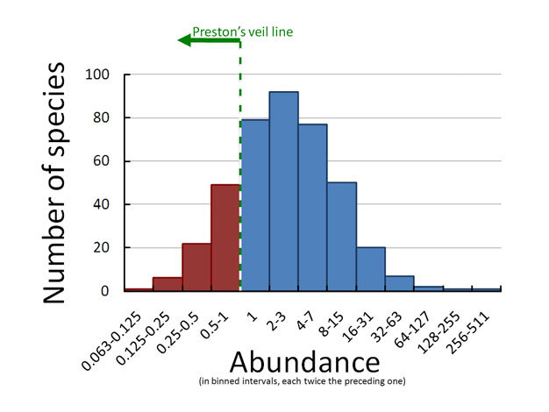

The Distribution & Abundance of Plants Question
Describe how you would investigate the distribution and abundance of plant species across a habitat.
____________________________________________________________________________________________________________________________________________________________________________________________________________________________________________________________________________________________________________________________________________________________________________________________________________________________________________________________________________________________________________________________________________________________________________________
Answer
Video link

