Slide 1







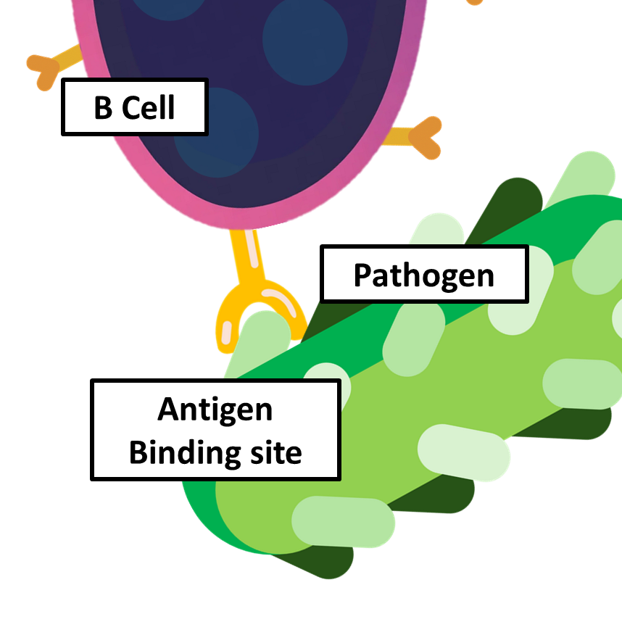







How Helper T Cells Act on B Cells
Co-stimulation and cytokine release – The T helper cell releases cytokines that fully activate the B cell.
Antigen internalisation – The B cell engulfs the antigen–antibody complex by endocytosis.
Differentiation – The B cells differentiate into plasma cells and memory B cells.
Antigen presentation – The antigen is processed and fragments are displayed on the B cell surface attached to MHC class II molecules.
Clonal expansion – The activated B cell divides by mitosis to form many genetically identical cells.
T Helper Cell
Plasma B Cell
Pathogen
B Cell
Cytokines
Antigen recognition – A B cell has specific antibodies on its surface that bind to a complementary antigen on a pathogen.
T helper cell binding – A T helper cell with a complementary T cell receptor binds to the antigen–MHC complex on the B cell.
Antibody production – Plasma cells produce and secrete large quantities of specific antibodies into the blood and lymph.

