Slide 1
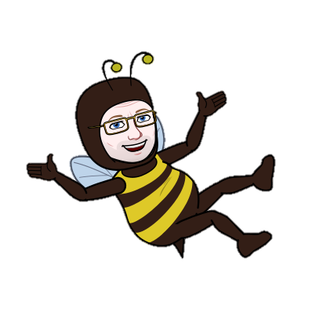
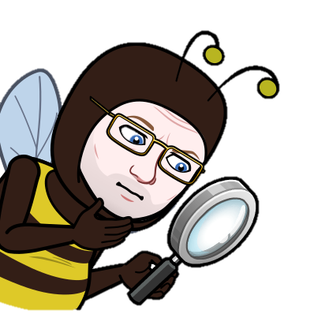
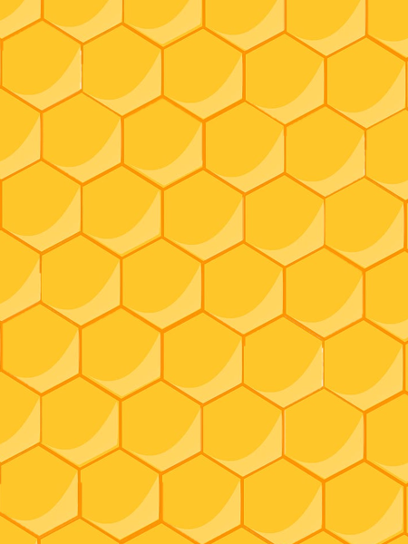
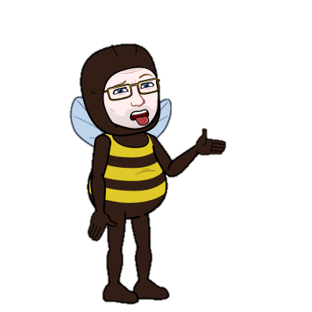
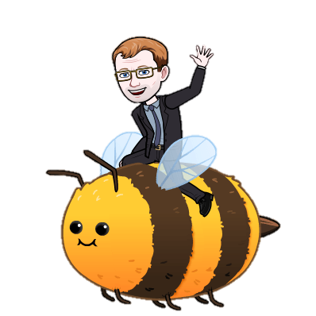
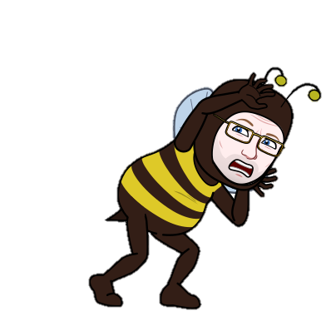
Why Are There Less Bees?
Pesticides
Invasive Species
The Asian Hornet, which recently arrived in the UK could devastate British bee species if they took hold and the Small hive beetle could damage Honeybee and Bumblebee colonies
Pesticides are designed to kill unwanted pests, but their toxic properties and widespread use are also harming beneficial insects such as bees.
Combined Effects
These individual causes are bad enough for bees, and there is evidence to show that they work in combination, weakening bees and other pollinating insects
Climate Change
As winters become warmer and wetter, and seasons shift there are signs that some wild species may be in the wrong place at the wrong time.
Habitat Loss
Pests & Disease
Changes in our land use, including insensitive urban development and intensive farming, have caused significant losses and fragmentation of pollinator-friendly habitats.
Bee keepers guard their honeybee colonies against a range of pests and diseases. These include the varroa mite or fungal diseases that affect the closely knit colony.
Intensive Farming
Modern intensive farming methods have resulted in the loss of traditional hay and flower meadows, hedgerows, trees and other habitats such as ponds and water meadows.

