Slide 1
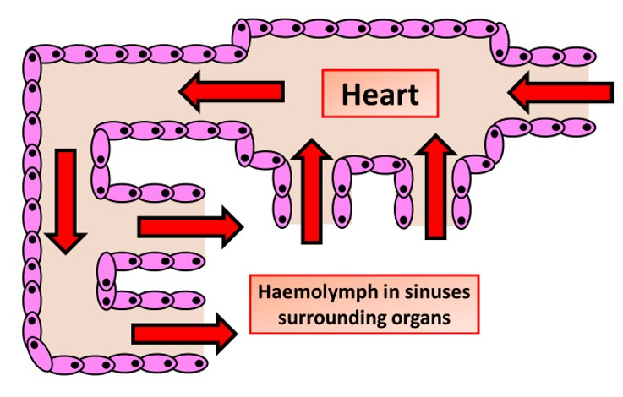

Open Circulation Question
The diagram below shows open circulation
Describe the key features of an open circulatory system.
________________________________________________________________________________________________________________________________________________________________________________________________________________________________________________________________________________________________________________________________________________________________________________________________________________________________________________________________________________________________________________________________________________________________________________________________________________________________________________________________________________________________________________________________________________________________________________
Answer
Link to video

