Slide 1
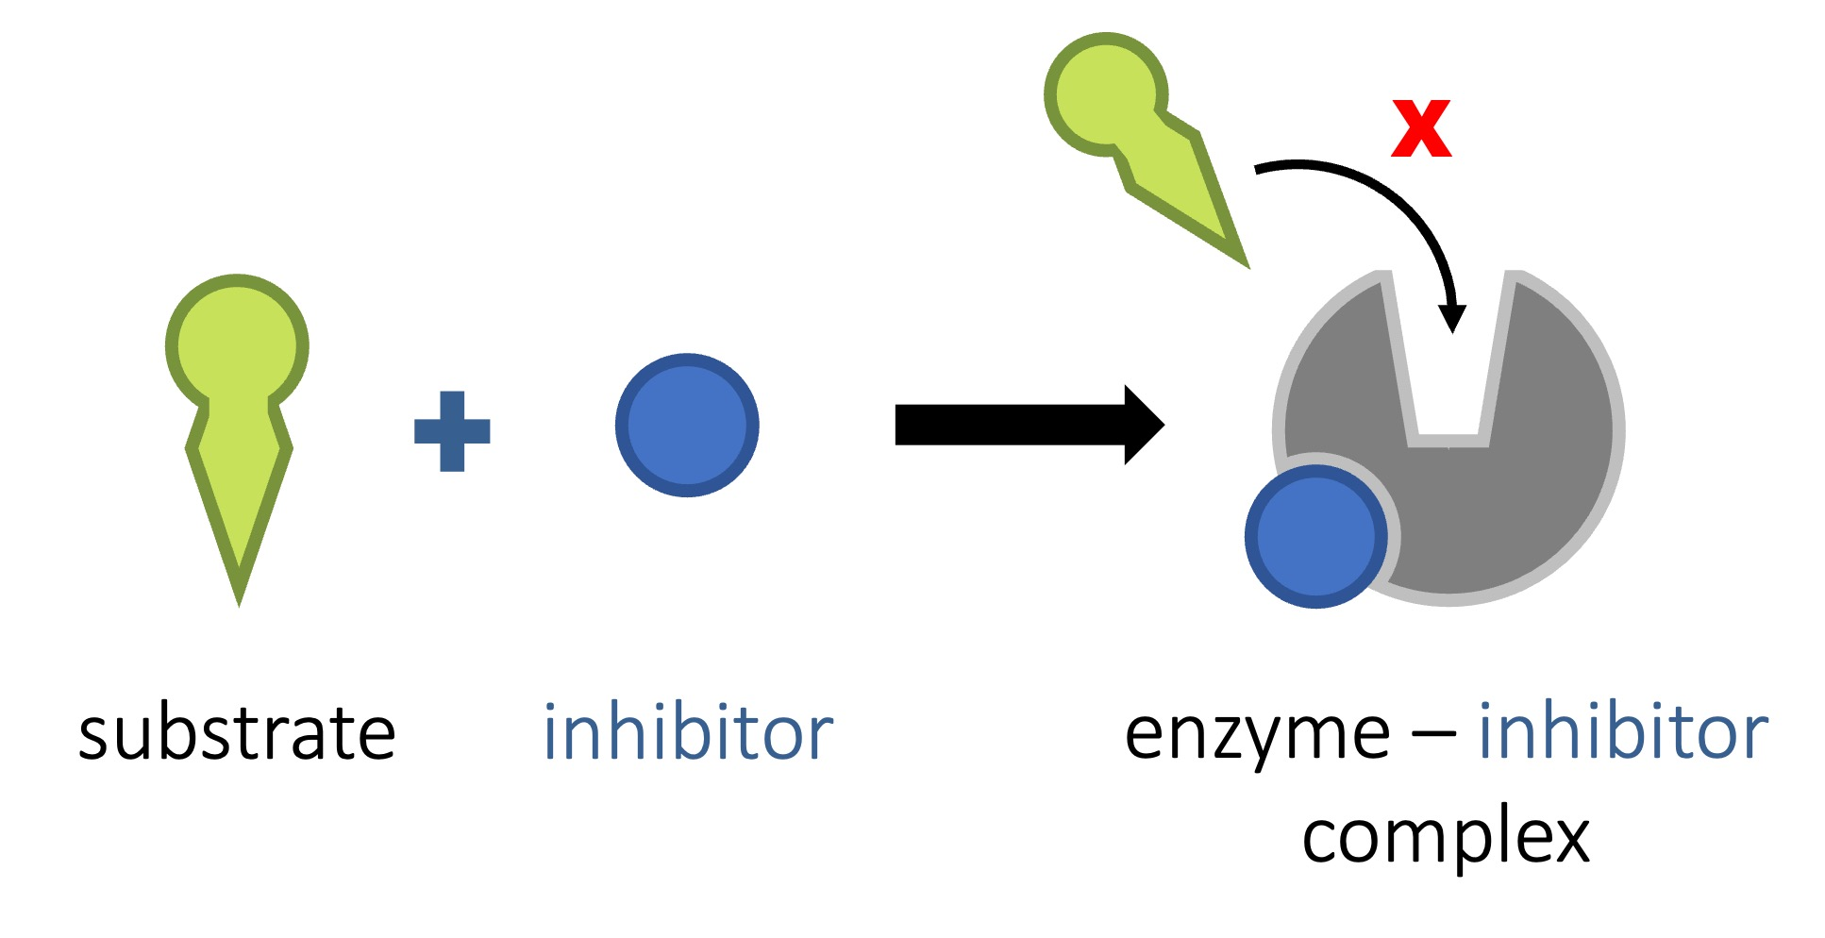

Non-Competitive Inhibition Question
Describe how non-competitive inhibitors affect the activity of enzymes.
___________________________________________________________________________________________________________________________________________________________________________________________________________________________________________________________________________________________________________________________________________________________________________________________________________________________________________________________________________________________________________________________________________________________________________________________________________________________________
Answer
Link to video

