Slide 1
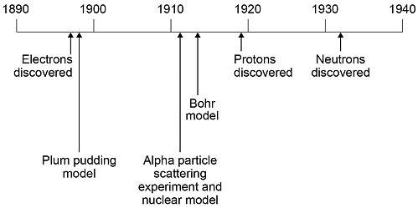

Atomic Theory Practice Question
This question is about the development of scientific theories. The diagram below shows a timeline of some important steps in the development of the model of the atom.
The plum pudding model did not have a nucleus. Describe three other differences between the nuclear model of the atom and the plum pudding model.
______________________________________________________________________________________________________________________________________________________________________________________________________________________________________________________________________________________________________________________________________________________________________________________________________________________________________________________________________________________
Answer
Link to video

Slide 2
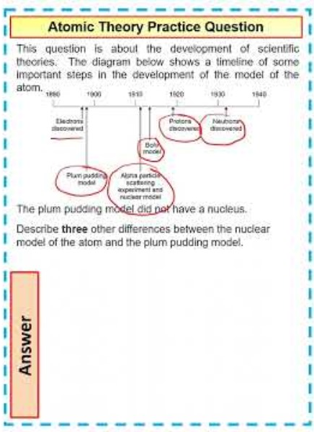
Atomic Theory Practice Question

Slide 3

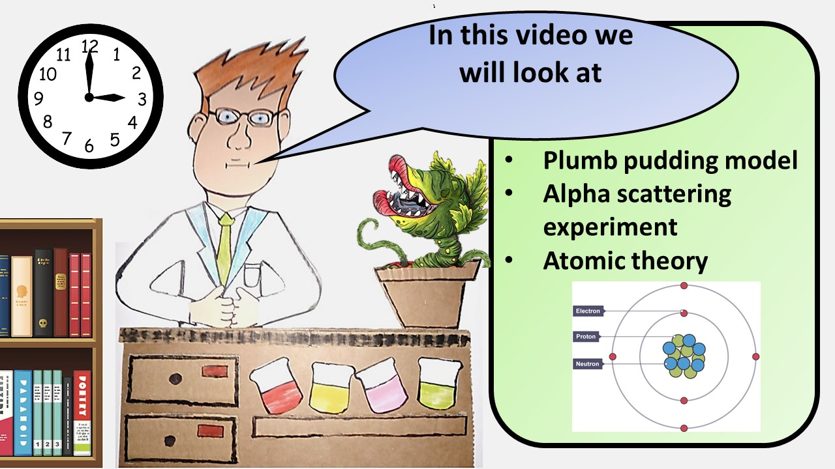


Click here to access my youtube videos
Resources that this activity would work well with
Lesson on TES
Lesson on TPT
Follow me on social media to stay in touch
Keep up to date with my new content:

