Slide 1
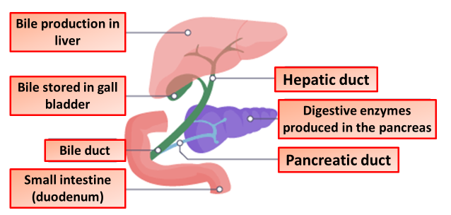

The Role of Bile in Digestion Question
The diagram shows part of the digestion system. Describe the role of bile in digestion.
Key things to include:
What does bile do to fat
How does bile help lipase
_______________________________________________________________________________________________________________________________________________________________________________________________________________________________________________________________________________________________________________________________________________________________________________________________________________________________________
Answer
Link to video

