Slide 1
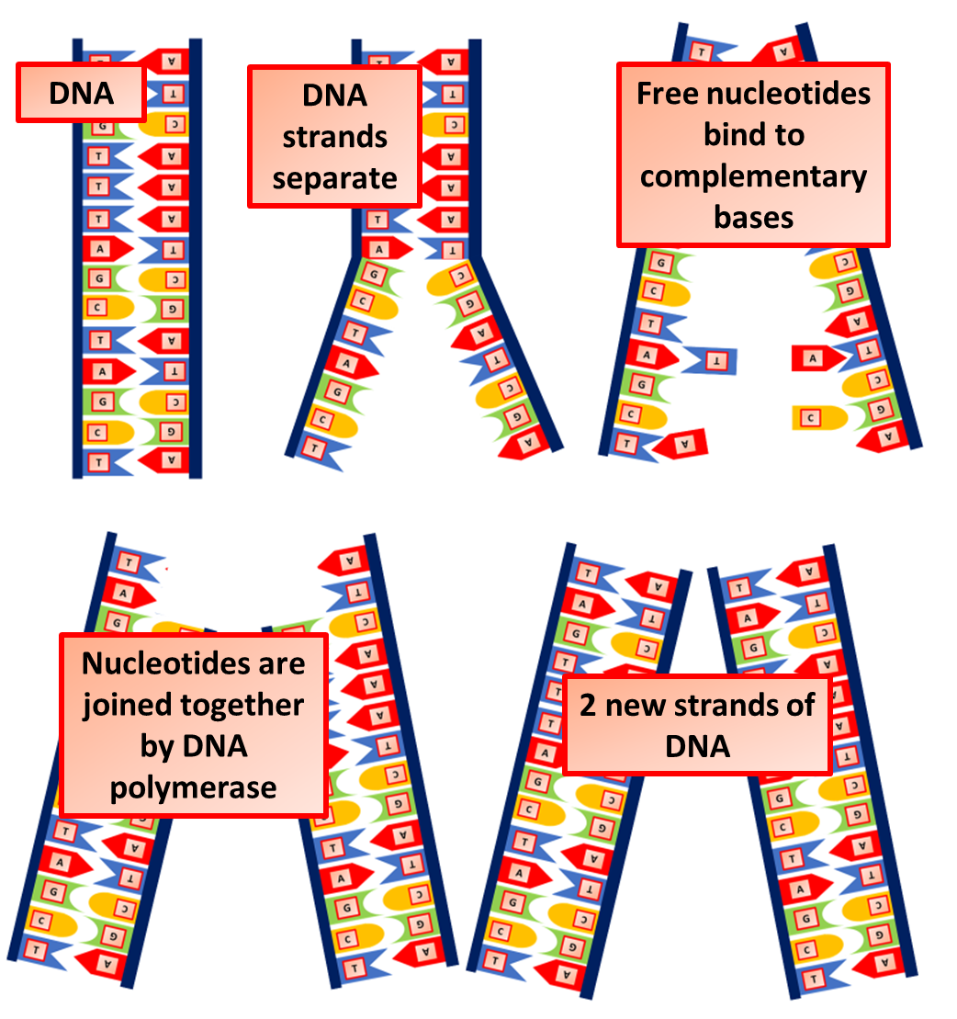

DNA Replication Question
The diagram below shows the process of DNA replication. Describe the process of DNA replication.
____________________________________________________________________________________________________________________________________________________________________________________________________________________________________________________________________________________________________________________________________________________________________________________________________________________________________________________________________________________________________________________________________________________________________________________
Answer
Video link

