Slide 1

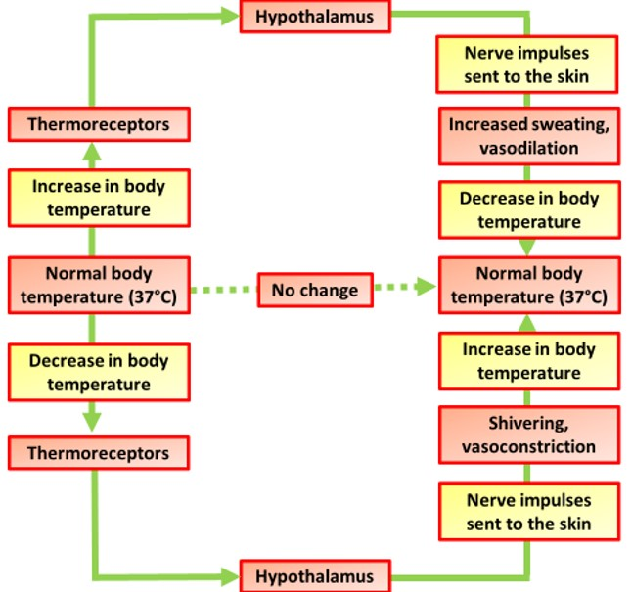
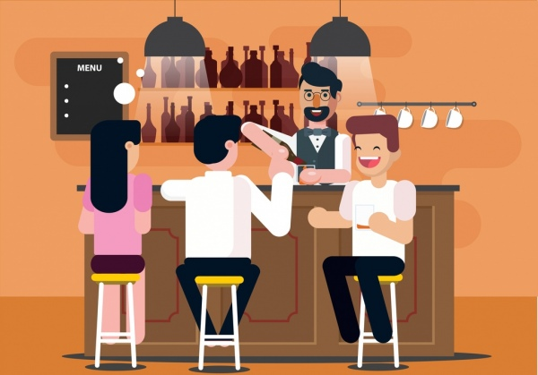
The Great Biology Pubish Quiz
Thermoregulation

Slide 2
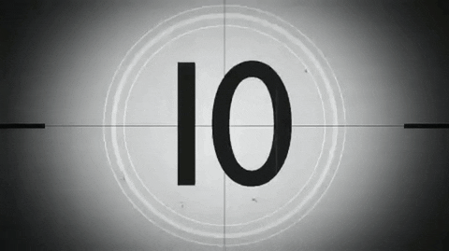
The Great Biology Pubish Quiz
Thermoregulation
Which part of the brain controls thermoregulation?
A
Cerebellum
Hypothalamus
B
C
Medulla
D
Pituitary

Slide 3
The Great Biology Pubish Quiz
Thermoregulation
Which process cools the body through liquid loss from the skin?
A
Sweating
Shivering
B
C
Vasoconstriction
D
Respiration

Slide 4
The Great Biology Pubish Quiz
Thermoregulation
Which blood vessel response helps conserve heat?
A
Vasodilation
Vasoconstriction
B
C
Evaporation
D
Thermoregulation

Slide 5
The Great Biology Pubish Quiz
Thermoregulation
What happens to hair erector muscles when the body is cold?
A
Relax
Shrink
B
C
Die
D
Contract

Slide 6
The Great Biology Pubish Quiz
Thermoregulation
Which hormone can raise body temperature during stress?
A
Insulin
Glucagon
B
C
Adrenaline
D
Melatonin

Slide 7
The Great Biology Pubish Quiz
Thermoregulation
Which term describes maintaining a constant body temperature?
A
Hydration
B
Respiration
C
Thermoregulation
D
Photosynthesis

Slide 8

The Great Biology Pubish Quiz
Thermoregulation
Question 1
B
Question 2
A
Question 3
B
Question 4
D
Question 5
C
Question 6
C

