Slide 1
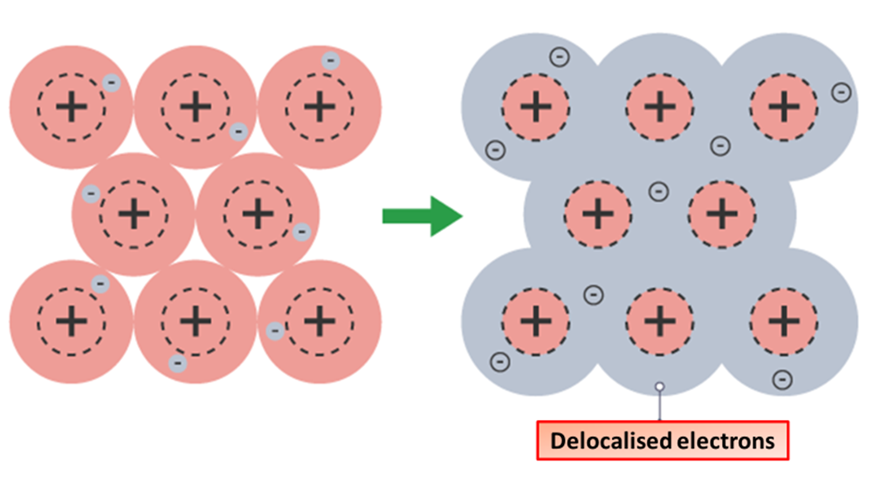

Metallic Bonding Question
The diagram shows how metals bond:
Video link
What do metal atoms form in metallic bonding?
What happens to the outer electrons in metallic bonding?
What holds metal atoms together?
Why can metals conduct electricity?

