Slide 1

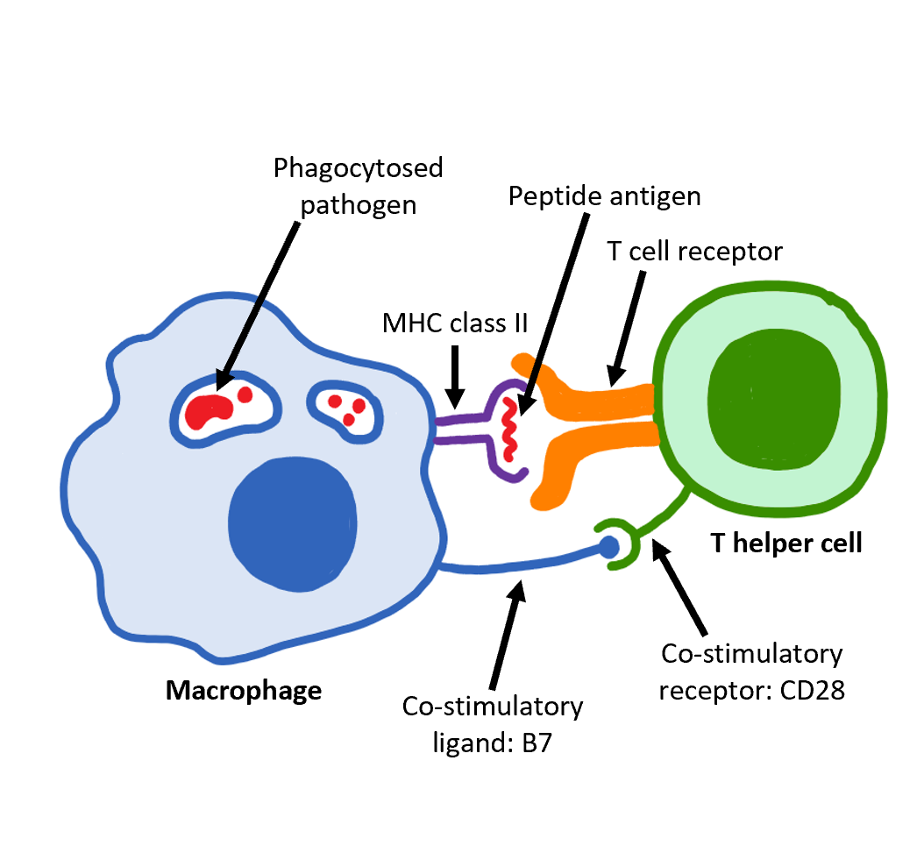

The Great Biology Pubish Quiz
The Role of T Cells

Slide 2

The Great Biology Pubish Quiz
The Role of T Cells
What type of T cell activates B cells?
A
Cytotoxic T cell
Memory T cell
B
C
Helper T cell
D
Suppressor T cell

Slide 3
The Great Biology Pubish Quiz
The Role of T Cells
What do cytotoxic T cells release to destroy infected cells?
A
Histamine
Perforin
B
C
Antibodies
D
Cytokines

Slide 4
The Great Biology Pubish Quiz
The Role of T Cells
What do memory T cells do?
A
Produce antibodies
Engulf pathogens
B
C
Kill infected cells
D
Provide a faster response on re-exposure

Slide 5
The Great Biology Pubish Quiz
The Role of T Cells
How do T cells recognise infected cells?
A
By detecting foreign DNA
By binding to antibodies
B
C
By detecting antigens on MHC molecules
D
By recognising damaged plasma membranes

Slide 6
The Great Biology Pubish Quiz
The Role of T Cells
What is the main role of helper T cells?
A
Destroy infected cells
B
Activate phagocytes
C
Stimulate other immune cells
D
Secrete antibodies

Slide 7
The Great Biology Pubish Quiz
The Role of T Cells
What do T cells mature in?
A
Bone marrow
Liver
B
C
Spleen
D
Thymus

Slide 8

The Great Biology Pubish Quiz
The Role of T Cells
Question 1
C
Question 2
B
Question 3
D
Question 4
C
Question 5
C
Question 6
D

