Slide 1
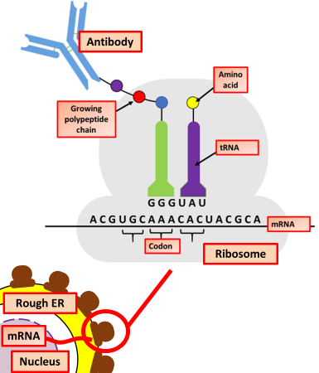

The Production of Antibodies Question
Describe how B cells produce antibodies during the immune response.
___________________________________________________________________________________________________________________________________________________________________________________________________________________________________________________________________________________________________________________________________________________________________________________________________________________________________________________________________________________________________________________________________________________________________________________________________________________________________
Answer
Link to video

