Slide 1
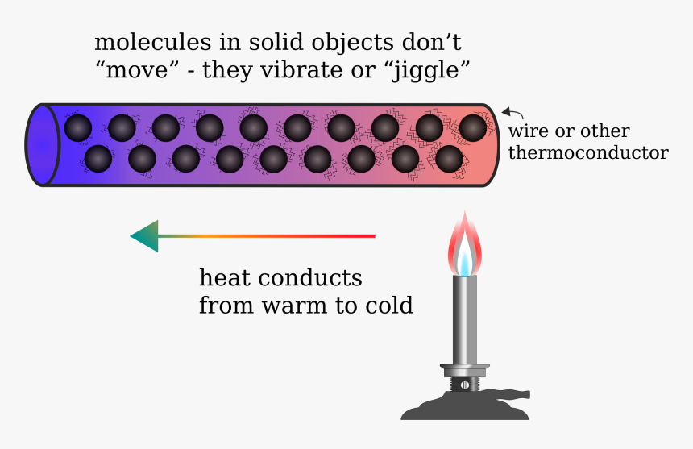
Conduction Question
Explain how heat is transferred through conduction in a solid
Key things to include:
What happens to atoms as they are heated
How are vibrations spread throughout a metal
How can electrons transfer energy
________________________________________________________________________________________________________________________________________________________________________________________________________________________________________________________________________________________________________________________________________________________________________________________________________________________________________
Answer
Link to video

