Slide 1
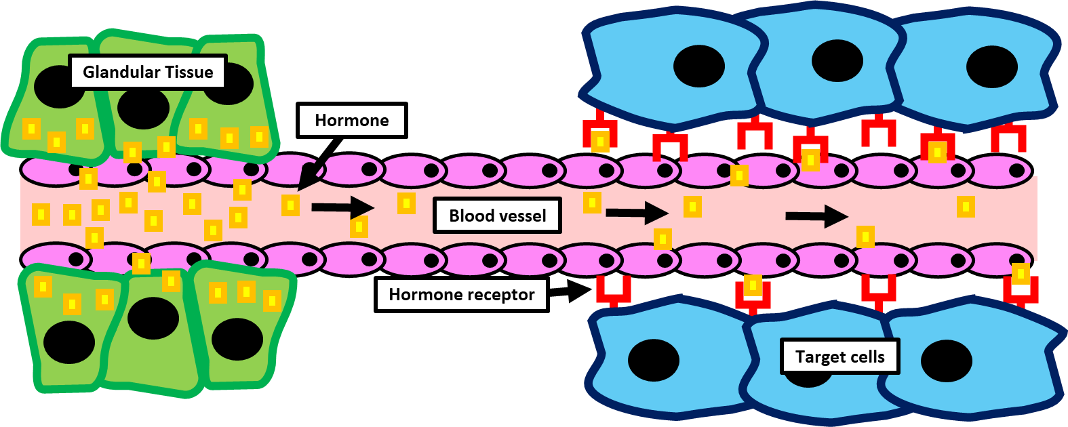

Hormone Action Question
The diagram below shows how hormones act on cells
Explain how hormones affect target tissues in the body.
________________________________________________________________________________________________________________________________________________________________________________________________________________________________________________________________________________________________________________________________________________________________________________________________________________________________________________________________________________________________________________________________________________________________________________________________________________________________________________________________________________________________________________________________________________________________________________
Answer
Link to video

