Slide 1
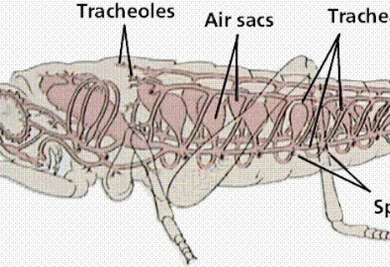
The Great Biology Pubish Quiz
Round 6: Gas Exchange in Insects

Slide 2
The Great Biology Pubish Quiz
Round 6
How do insects primarily take in oxygen for gas exchange?
A
Through their skin
Through their circulatory system
B
C
Through spiracles and a tracheal system
D
Through their gills

Slide 3
The Great Biology Pubish Quiz
Round 6
What is the role of spiracles in the insect respiratory system?
A
To pump blood throughout the body
To open and close to regulate gas exchange and water loss
B
C
To trap food particles
D
To produce mucus for respiration

Slide 4
The Great Biology Pubish Quiz
Round 6
How does oxygen travel from the spiracles to the cells in an insect?
A
Through blood vessels
Through the tracheal tubes and tracheoles
B
C
Through diffusion across the skin
D
By active transport across membranes

Slide 5
The Great Biology Pubish Quiz
Round 6
Which of the following is a key adaptation of tracheoles that enhances gas exchange in insects?
A
Thick, muscular walls
A large surface area and proximity to cells
B
C
A high concentration of red blood cells
D
Water impermeability

Slide 6
The Great Biology Pubish Quiz
Round 6
What is the main purpose of ventilation movements in larger insects?
A
To increase blood flow to the wings
To maintain a concentration gradient for gas exchange
B
C
To regulate temperature
D
To trap food particles in the spiracles

Slide 7
The Great Biology Pubish Quiz
Round 6
Why don’t insects rely on their circulatory system to transport gases?
A
Their blood does not carry oxygen
Their circulatory system is closed
B
C
Their tracheal system directly supplies oxygen to cells
D
They only need carbon dioxide for respiration

Slide 8
The Great Biology Pubish Quiz
Round 5
Question 1
C
Question 2
B
Question 3
B
Question 4
B
Question 5
B
Question 6
C

