Slide 1
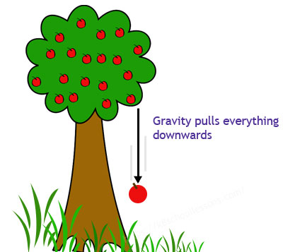
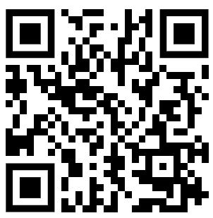
Gravity Question
Explain the effects of gravity on objects both on Earth and in space
Key things to include:
What is gravity
What affects gravity
________________________________________________________________________________________________________________________________________________________________________________________________________________________________________________________________________________________________________________________________________________________________________________________________________________________________________
Answer
Link to video

