Slide 1
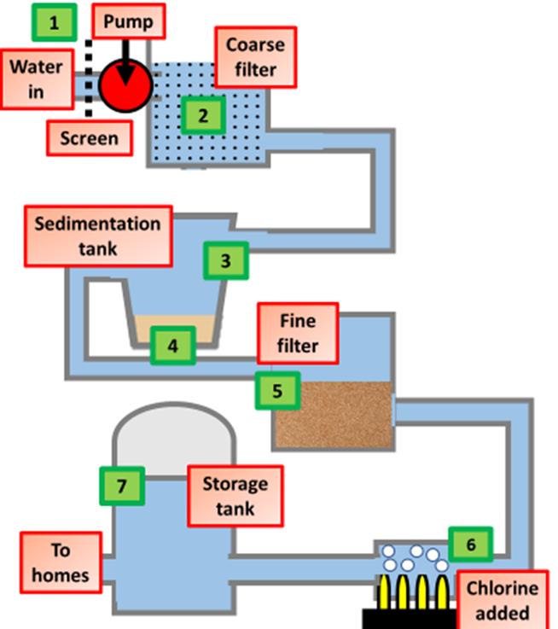

Water Treatment Question
The diagram shows how water is treated
Video link
What is potable water?
What is the first step in water treatment?
Why is chlorine added to drinking water?
What is the purpose of filtration in water treatment?

