Slide 1
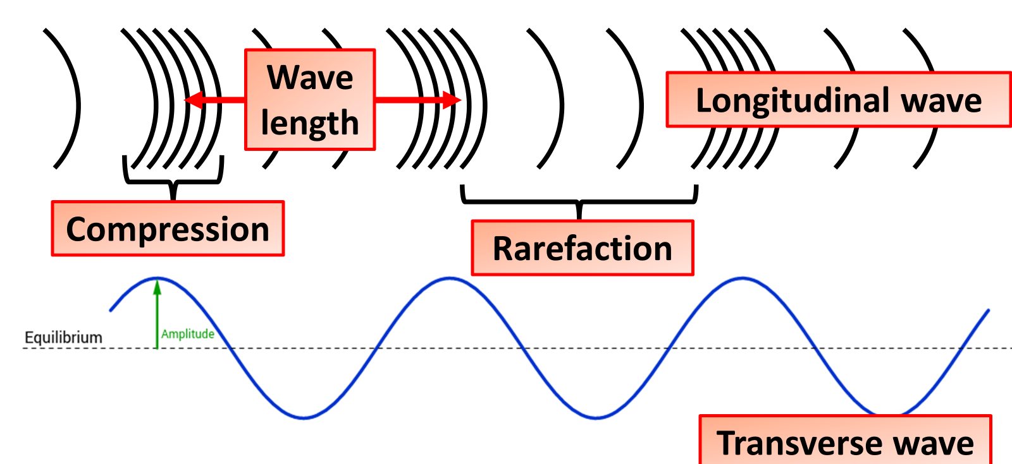

Types of Waves Practice Question
Waves may be longitudinal or transverse.
Describe the differences between longitudinal waves and transverse waves.
Key things to include:
What causes waves
How is energy transferred in a longitudinal wave
How is energy transferred in a transverse wave
Answer
________________________________________________________________________________________________________________________________________________________________________________________________________________________________________________________________________________________________________________________________________________________________________________________
Link to video

Slide 2
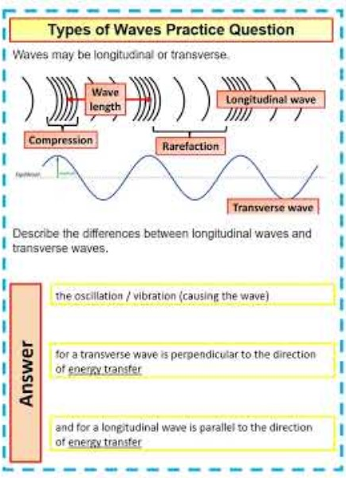
Types of Waves Practice Question

