Slide 1
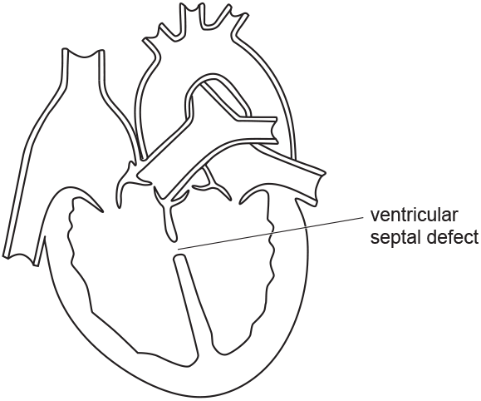
Ventricular Septal Defect Question
A ventricular septal defect (VSD) is a hole in the septum of the heart. The diagram below shows a heart with VSD. Describe and explain why people with VSD can easily become tired.
____________________________________________________________________________________________________________________________________________________________________________________________________________________________________________________________________________________________________________________________________________________________________________________________________________________________________________________________________________________________________________________________________________________________________________________
Answer
Video link

