Slide 1
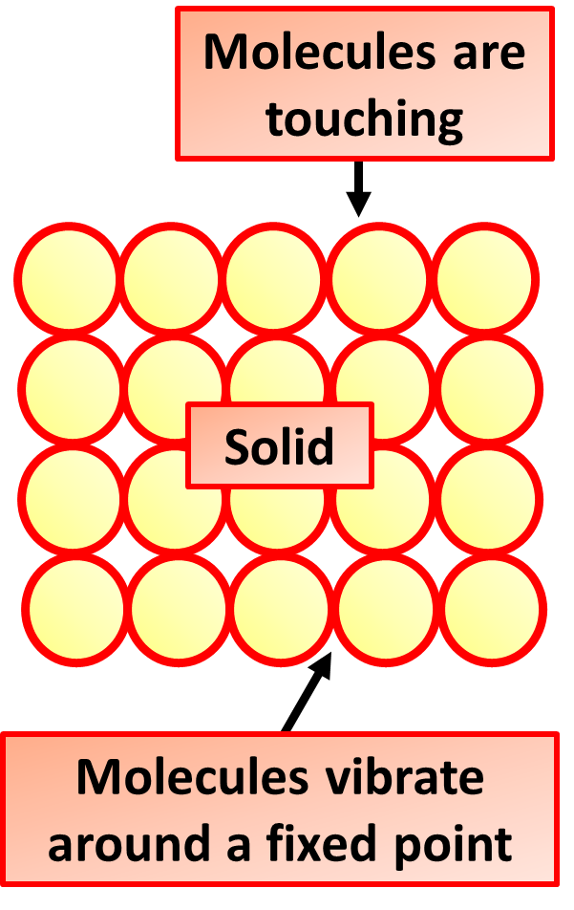
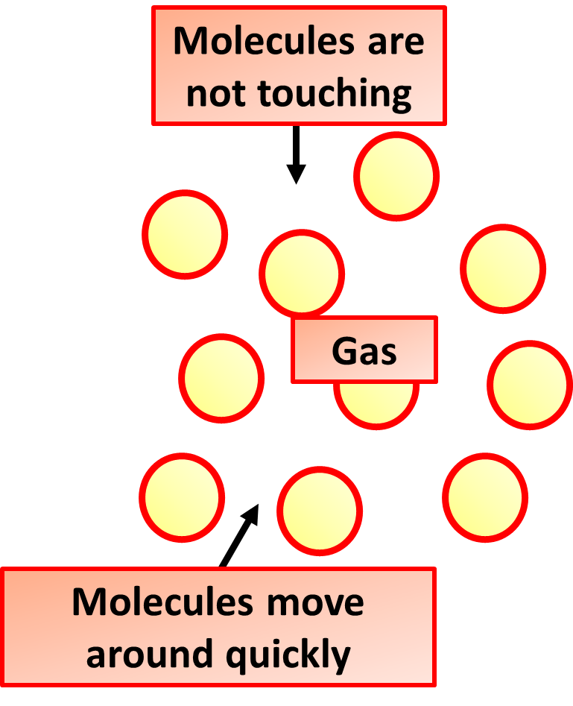

Particle Model Practice Question
Solid, liquid and gas are three different states of matter.
Describe the difference between the solid and gas states, in terms of the arrangement and movement of their particles.
Key things to include:
How are the particles arranged and how do they move in solids
How are the particles arranged and how do they move in solids
Answer
________________________________________________________________________________________________________________________________________________________________________________________________________________________________________________________________________________________________________________________________________________________________________________________
Link to video

Slide 2
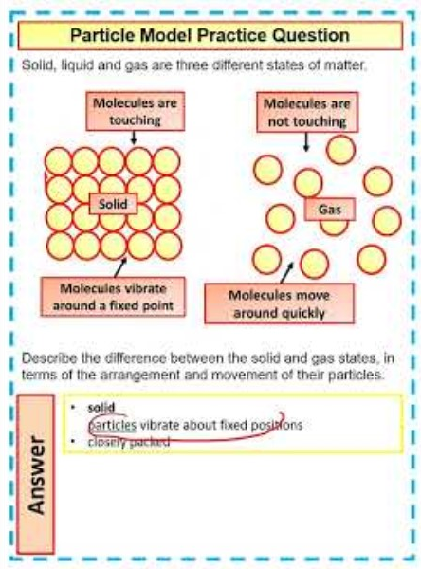
Particle Model Practice Question

