Slide 1
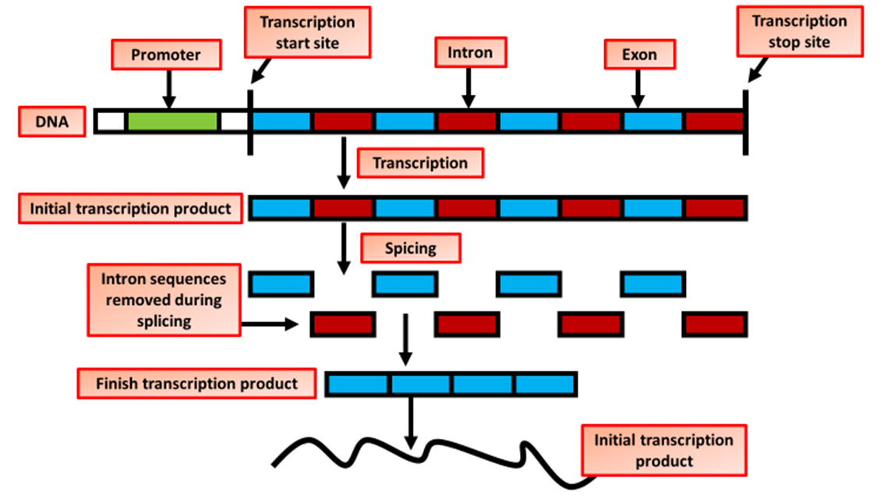

RNA Editing Question
The diagram below shows how gene transcription is controlled. Describe how transcriptional control regulates gene expression.
____________________________________________________________________________________________________________________________________________________________________________________________________________________________________________________________________________________________________________________________________________________________________________________________________________________________________________________________________________________________________________________________________________________________________________________
Answer
Video link

