Slide 1
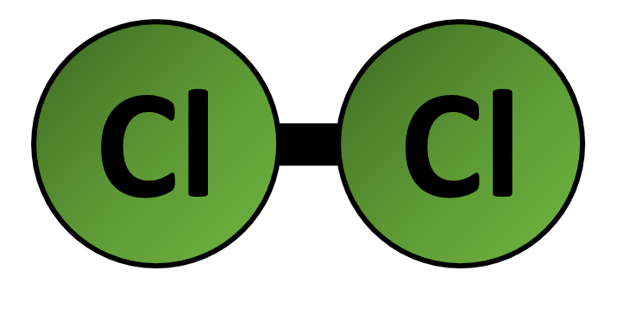
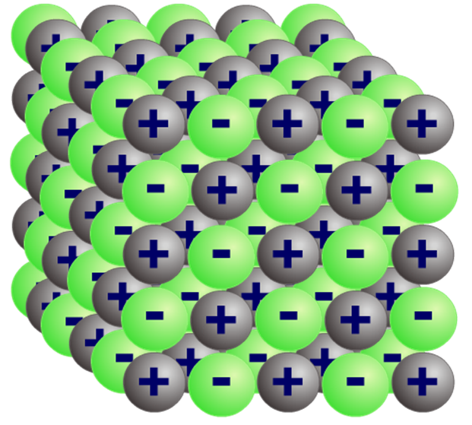
Differences Between Molecules Question
Explain why chlorine (Cl2) is a gas at room temperature, but sodium chloride (NaCl) is a solid at room temperature.
Chlorine Sodium chloride
Include a description of the bonding and structure of chlorine and sodium chloride in your answer.
Key things to include:
Describe the bonding in giant ionic compounds
Describe the bonding in simple covalent bonding
______________________________________________________________________________________________________________________________________________________________________________________________________________________________________________________________________________________________________________________________________________________________________________________________________________________________________________________________________________________
Answer
Link to video

Slide 2
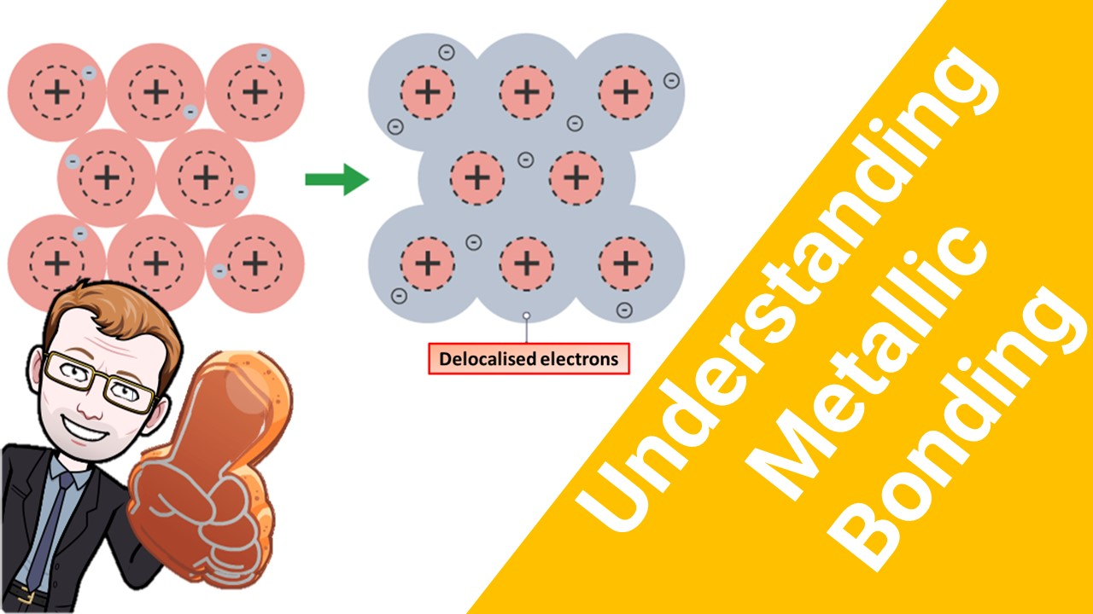
Click here to access my bonding youtube videos
Resources that this activity would work well with
Lesson on TES
Lessons on TPT
Follow me on social media to stay in touch
Keep up to date with my new content:

