Slide 1
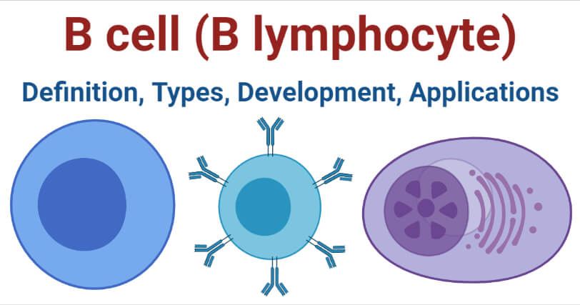

The Role of B Cells Question
Describe the role of B cells in the immune response.
___________________________________________________________________________________________________________________________________________________________________________________________________________________________________________________________________________________________________________________________________________________________________________________________________________________________________________________________________________________________________________________________________________________________________________________________________________________________________
Answer
Link to video

