Slide 1
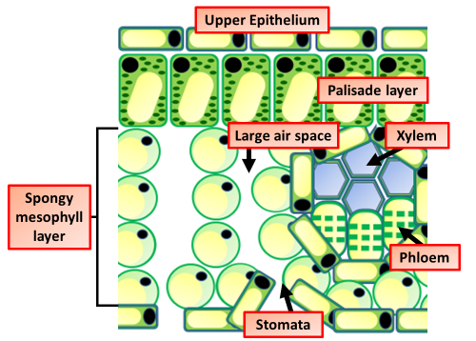

Leaf Structure Question
Describe how the structure of a leaf is adapted for photosynthesis.
Key things to include:
How are palisade cells adapted
What is the role of stomata’s
What are the roles of phloem & xylem
_______________________________________________________________________________________________________________________________________________________________________________________________________________________________________________________________________________________________________________________________________________________________________________________________________________________________________
Answer
Link to video

